Slide 1
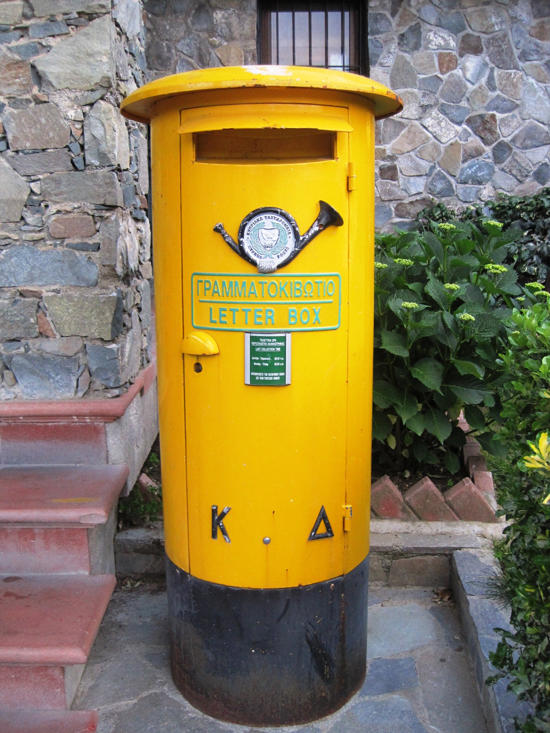
Queues Crash Course
Transactional Outbox
Transactional Inbox
CDC (Change Data Capture)

Slide 2
Distributed databases, same state
App/1
App/2
Data
DB 1
DB 2
Data

Slide 3
Distributed databases, same state
App/1
App/2
How to sync?
Data
DB 1
DB 2
Data

Slide 4
Transactional outbox
App/1
App/2
Q
DB 1
DB 2
Data

Slide 5
Transactional outbox
App/1
App/2
Q
DB 1
DB 2
How to sync?
Data

Slide 6
Transactional outbox
App/1
App/2
Q
DB 1
DB 2
Data

Slide 7
Transactional outbox
App/1
App/2
Transaction
Q
Outbox
DB 1
DB 2
Data

Slide 8
Transactional outbox
App/1
App/2
Transaction
Q
Outbox
DB 1
DB 2
Data
Queue-in-a-database

Slide 9
Transactional outbox
App/1
DB→Q
App/2
Transaction
Q
Outbox
DB 1
DB 2
Data

Slide 10
Transactional outbox
App/1
DB→Q
App/2
At least once
Transaction
Q
Outbox
DB 1
DB 2
Data
Unique identifier

Slide 11
Transactional inbox
App/1
DB→Q
App/2
Q
Outbox
Data
DB 1
Q→DB
DB 2
Data

Slide 12
Transactional inbox
App/1
DB→Q
App/2
Q
Outbox
Data Data
DB 1
Q→DB
DB 2
Data

Slide 13
Transactional inbox
App/1
DB→Q
App/2
Q
Transaction
Outbox
Data
DB 1
Q→DB
DB 2
Data
Inbox
Unique constraint
Check-if-already-processed

Slide 14
Transactional inbox
App/1
DB→Q
App/2
At least once
Q
Transaction
Outbox
Data
DB 1
Q→DB
DB 2
Data
Inbox
Idempotency
Unique constraint

Slide 15
CDC: Change Data Capture
App/1
DB→Q
App/2
At least once
Q
Transaction
Outbox
Data
DB 1
Q→DB
DB 2
Data
Inbox
Idempotency
Unique constraint

Slide 16
CDC: Change Data Capture
App/1
App/2
CDC
Capture changes
Deliver changes
Data
DB 1
DB 2
Data

Slide 17
CDC: Change Data Capture
App/1
DB→Q
App/2
Q
Transaction
Outbox
Data
DB 1
Q→DB
DB 2
Data
Inbox

Slide 18
CDC: Change Data Capture
App/1
DB→Q
App/2
Q
Outbox
Data + Inbox
DB 1
Q→DB
DB 2
Data
Unique constraint

Slide 19
Capture changes, no intrusion
App/1
App/2
Q
Data + Inbox
DB 1
Q→DB
DB 2
Data
Unique constraint
WAL

Slide 20
Capture changes, no intrusion
App/1
App/2
Q
Data + Inbox
DB 1
Q→DB
DB 2
Data
Replica
Unique constraint
WAL

Slide 21
Capture changes, no intrusion
App/1
App/2
Behave like replica
Q
Data + Inbox
DB 1
Q→DB
DB 2
Data
DB→Q
Unique constraint
WAL

Slide 22
Capture changes, no intrusion
App/1
App/2
Q
Data + Inbox
DB 1
Q→DB
DB 2
Data
DB→Q
Unique constraint
WAL

Slide 23
CDC from WAL
App/1
App/2
Q
Data + Inbox
DB 1
Q→DB
DB 2
Data
DB→Q
Unique constraint
WAL
Unique identifier
At least once

Slide 24
CDC Approaches
Timestamps/version/status on rows (major intrusion)
Requires schema modifications
Alteration of application
Additional database load
Triggers on tables (minor intrusion)
Opaque for the application
Additional database load
Capture replication/wal (no intrusion)
No additional database load
No effect on schema or application

Slide 25
App/1
DB→Q
App/2
At least once
Transaction
Q
Transaction
Outbox
Data + Inbox
DB 1
Q→DB
DB 2
Data
Idempotency
Unique identifier
Unique constraint
Replica
WAL

Slide 26
Further reading

Slide 27
Further reading
https://softwaremill.com/microservices-101/
https://microservices.io/patterns/data/transactional-outbox.html
https://microservices.io/patterns/data/transaction-log-tailing.html
https://en.wikipedia.org/wiki/Inbox_and_outbox_pattern
https://debezium.io/

Slide 28
Homework
Implement consistent transaction replication flow
Deliver transactions from one database to another
Maintain consistency in the face of every component outage
Use queue or implement direct outbox-to-inbox

Slide 29
Demo

Slide 30
user-id
amount
external txn id
tx
Tx processor
(app)
Balance viewer
DB transactions
DB balance
Balance account_id balance
Transactions
id external_id account_id amount …
Balance account_id balance

Slide 31
user-id
amount
external txn id
tx
Tx processor
(app)
Balance viewer
Outbox processor
DB transactions
DB balance
Kafka
Balance account_id balance
Inbox processor
Transactions
id external_id account_id amount …
Balance account_id balance
Outbox id (event) account_id transaction_id payload (blob) processed [Y/N]
Inbox transaction_id

Slide 32
user-id
amount
external txn id
Exactly once = At least once + Idempotence
tx
Tx processor
(app)
Balance viewer
Outbox processor
DB transactions
DB balance
Kafka
Balance account_id balance
Inbox processor
Transactions
id external_id account_id amount …
Balance account_id balance
Outbox id (event) account_id transaction_id payload (blob) processed [Y/N]
Inbox transaction_id

Slide 33
user-id
amount
external txn id
Exactly once = At least once + Idempotence
tx
Tx processor
(app)
Balance viewer
Outbox processor
At least once
DB transactions
DB balance
Kafka
Idempotency
Balance account_id balance
Inbox processor
Transactions
id external_id account_id amount …
Balance account_id balance
Outbox id (event) account_id transaction_id payload (blob) processed [Y/N]
Inbox transaction_id
Unique constraint

Slide 34
user-id
amount
external txn id
Exactly once = At least once + Idempotence
tx
Tx processor
(app)
Balance viewer
Outbox processor
At least once
DB transactions
DB balance
Kafka
Balance account_id balance
Inbox processor
Transactions
id external_id account_id amount …
Balance account_id balance
Outbox id (event) account_id transaction_id payload (blob) processed [Y/N]
Idempotency
Inbox transaction_id
Unique constraint

Slide 35
user-id
amount
external txn id
Exactly once = At least once + Idempotence
tx
Tx processor
(app)
Balance viewer
Outbox processor
At least once
At least once
DB transactions
DB balance
Kafka
Idempotency
Balance account_id balance
Inbox processor
Transactions
id external_id account_id amount …
Balance account_id balance
Outbox id (event) account_id transaction_id payload (blob) processed [Y/N]
Idempotency
Inbox transaction_id
Unique constraint
Unique constraint

Slide 36
user-id
amount
external txn id
Exactly once = At least once + Idempotence
tx
Tx processor
(app)
Balance viewer
At least once
Kafka Connect
DB transactions
DB balance
Idempotency
Balance account_id balance
Transactions
id external_id account_id amount …
Balance account_id balance
Outbox id (event) account_id transaction_id payload (blob) processed [Y/N]
Idempotency
Inbox transaction_id
Unique constraint
Unique constraint

